Slide 1
Servlets and JSP

Slide 2
Review-
Overview of Web Application
HTTP Methods and Responses

Slide 3
Outline
Overview of Web Application
HTTP Methods and Responses
Lifecycle of Web Servlets
Writing Servlet programs with Servlet APIs
Reading and Processing Forms
Handling GET/POST Requests
Database connectivity through servlets
Cookies and Sessions

Slide 4
Life Cycle Overview
Initialization
Servlet container loads and initializes the servlet when the first request is received.
init() method is called during initialization.
Handling Requests
Servlet handles multiple requests concurrently through multithreading.
service() method is invoked for each request, delegating to doGet() or doPost() based on the request type.
Termina ion
Servlet container calls destroy() method when shutting down or reloading the web application.
Cleanup operations are performed in the destory() method.

Slide 5
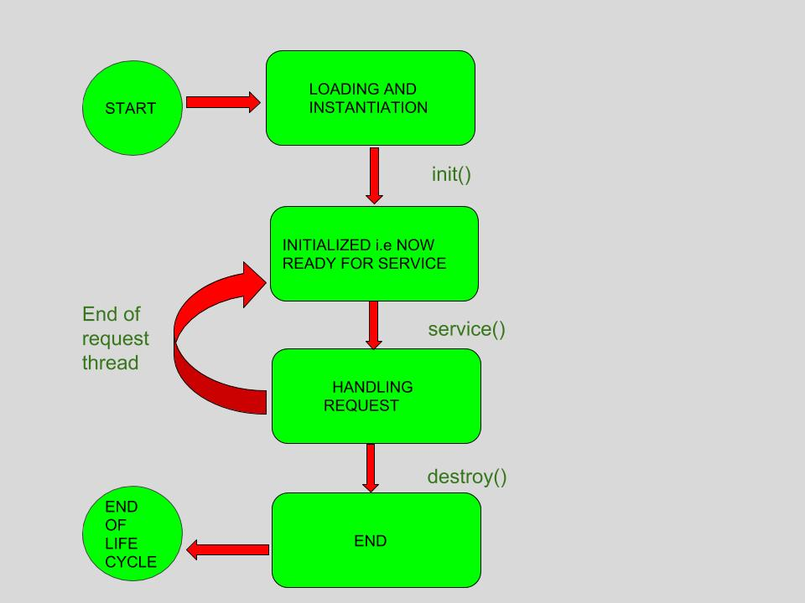
Lifecycle Contd..

Slide 6
Writing Servlet Programs with Servlet APIs
Import Statements:
Import necessary classes from the javax.servlet package.
Extending HttpServlet:
Servlet classes extend HttpServlet to handle HTTP requests.
Overriding Methods:
Override doGet() or doPost() methods to handle specific request types.

Slide 7
Handling Requests and Sending Responses
Request and Response Objects:
Use HttpServletRequest to retrieve client data.
Use HttpServletResponse to send data back to the client.

Slide 8
Reading and Processing Forms
HTML Forms:
HTML forms allow users to submit data to a server.
Elements like text fields, checkboxes, radio buttons, and buttons are used in forms.
Servlet Form Handling:
Form Submission: Forms are submitted to the server using the POST or GET method.
Processing Form Data in Servlets: Retrieve form data using request.getParameter() method.
Example: Demonstrate a servlet that reads and processes form data.

Slide 9
Handling GET/POST Requests
GET vs POST:
GET requests append data to the URL.
POST requests send data in the request body.
HttpServlet Methods:
doGet() Method:
Invoked for HTTP GET requests.
Used to retrieve data from the server.
doPost() Method:
Invoked for HTTP POST requests.
Used to submit data to the server.

Slide 10
Database Connectivity Through Servlets
Use JDBC to establish a connection to the database.
Load JDBC driver, create a connection, and obtain a statement.
Use PreparedStatement to execute SQL queries.
Secure way to handle parameters in queries.

Slide 11
Cookies and Sessions
Cookies
Small pieces of data stored on the client's browser.
Retaining user-specific information between requests
Session
HttpSession interface is used for session management.
Allows the server to store and retrieve user-specific information

Slide 12
Handling Cookies and Sessions in Servlets
Creating Cookies:
Use Cookie class to create cookies and add them to the response.
Managing Sessions:
Use HttpSession to store and retrieve session data.

Slide 13
Creating Cookie
public class CookieServlet extends HttpServlet {
protected void doGet(HttpServletRequest request, HttpServletResponse response)
throws ServletException, IOException {
Cookie cookie = new Cookie("username", "JohnDoe"); // Create a new cookie
cookie.setMaxAge(24 * 60 * 60); // Set the maximum age to 24 hours (24 * 60 * 60 seconds)
response.addCookie(cookie); // Add the cookie to the response
response.setContentType("text/html"); // Set response content type
response.getWriter().println("Cookie has been set with name 'username' and value 'JohnDoe'."); // Write a response to the client
}
}

Slide 15
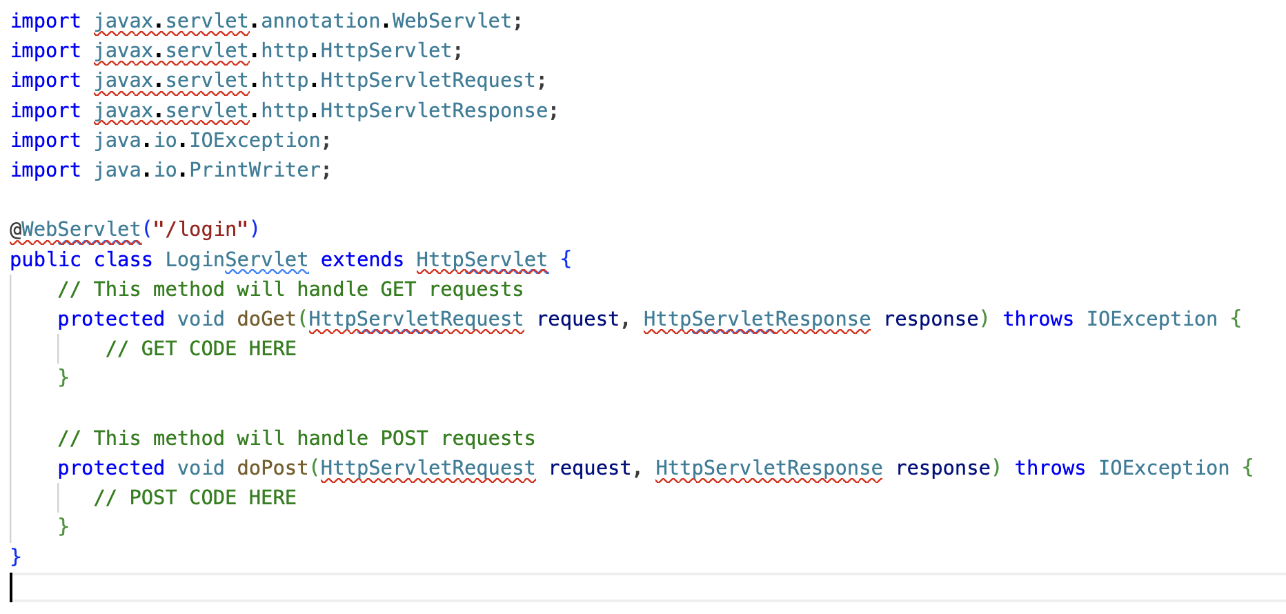
Servlet: Example

Slide 16
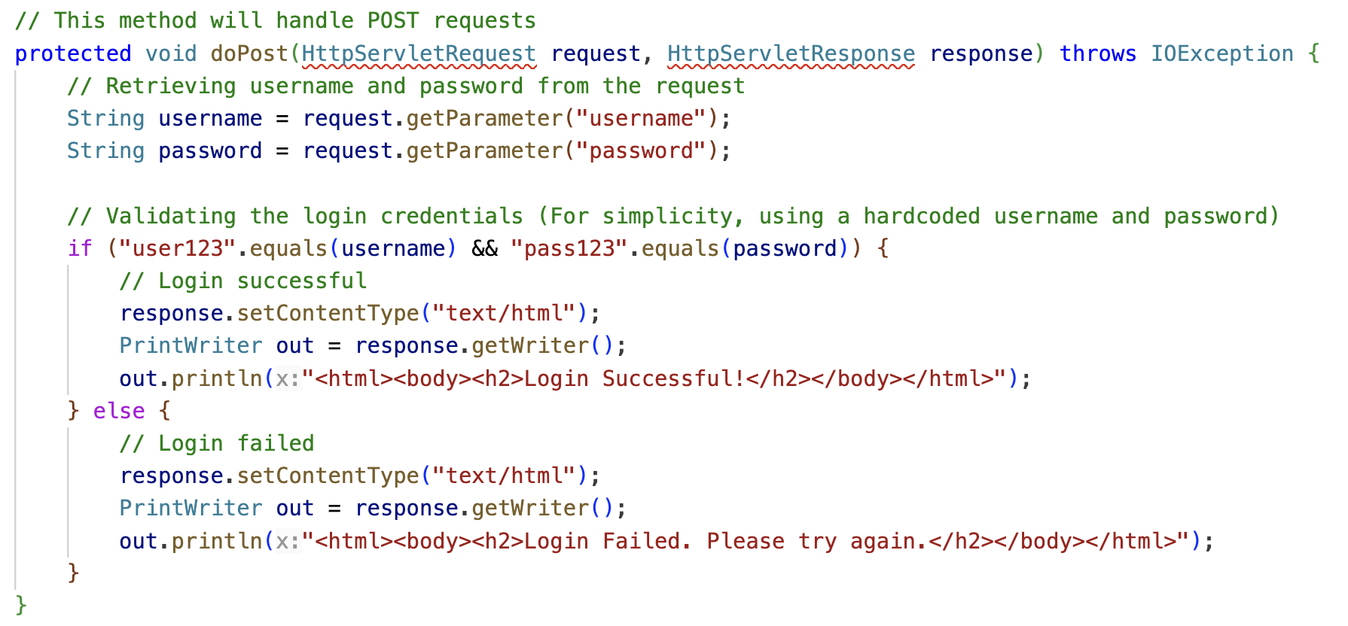
doPost()

Slide 17
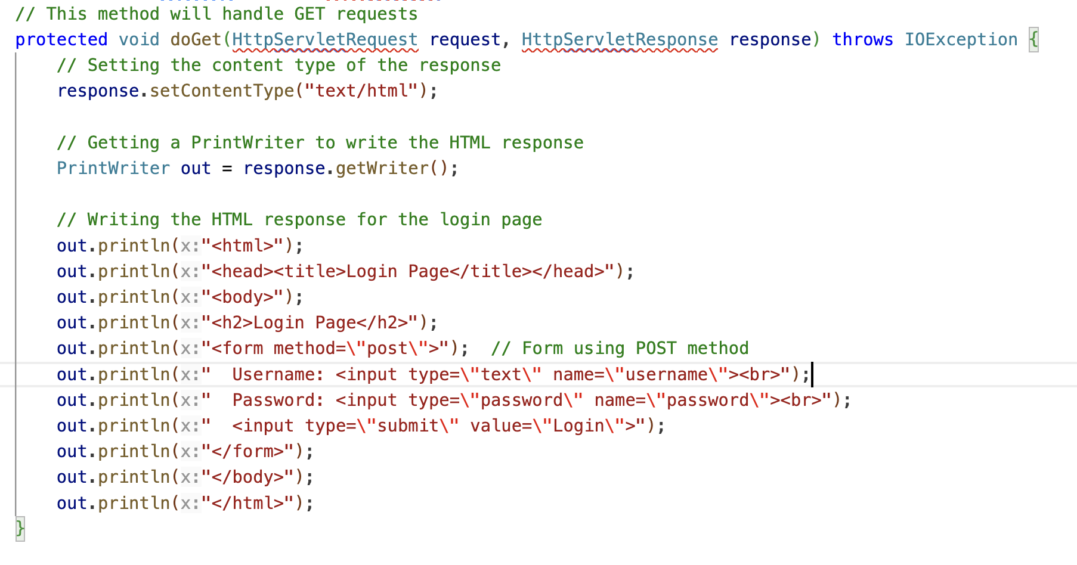
doGet()

Slide 18
Thank You!

Slide 19
Session and Cookies

